Slide 1






LEAVE MANAGEMENT SYSTEM
TEAM- 03

Slide 2



MEET OUR TEAM
TEAM LEAD
Hemashri U
230701114
TEAM MEMBERS
Harshitha M A
Himeshwar N
Hemnath V
230701112
230701116
230701115

Slide 3


Introduction
Managing student leave requests efficiently is a challenge for educational institutions due to manual processing, delays, and lack of transparency. This project proposes an automate leave approval based on historical data, academic performance, attendance records, and institutional policies.
The system provides a web application where students can submit leave requests, and faculty members can track and manage them. The ML model predicts leave approval probability by analyzing factors such as attendance percentage, exam schedules, previous leave history, and faculty feedback, ensuring a fair, data-driven, and automated approval process.
This system minimizes manual workload for faculty, provides real-time leave tracking, and enhances student accountability.

Slide 4

Why we need this application?
APPS | CURRENT LIMITATIONS | SOLUTION
Ed-Admin | Complex Interface: The system can be overwhelming due to the number of features included. | Simplified Interface – User-friendly and easy to navigate.
Fedena | Shortage of attendance alert system is no present | Attendance Alerts – Real-time notifications for low attendance.
My Class Campus | No proper visual representation user for data representation (like attendance percentage) | Better Data Visualization – Graphs and charts for clear insights.
OpenSIS | The open-source version lack many critical features available in the paid version | Full Feature Access- No limitations like the open-source version
College Management System | Some versions may not efficiently handle a large number of users. | High Scalability – Efficiently handles a large number of users.

Slide 5


UNIFIED MODELING LANGUAGE
State Diagram
User Diagram
Activity Diagram
Sequence Diagram
Class Diagram

Slide 6


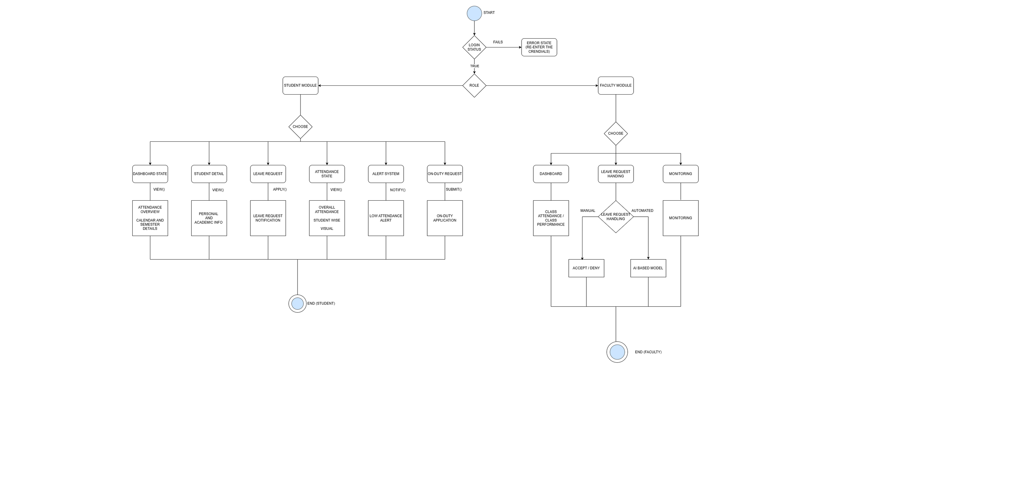

STATE DIAGRAM

Slide 7

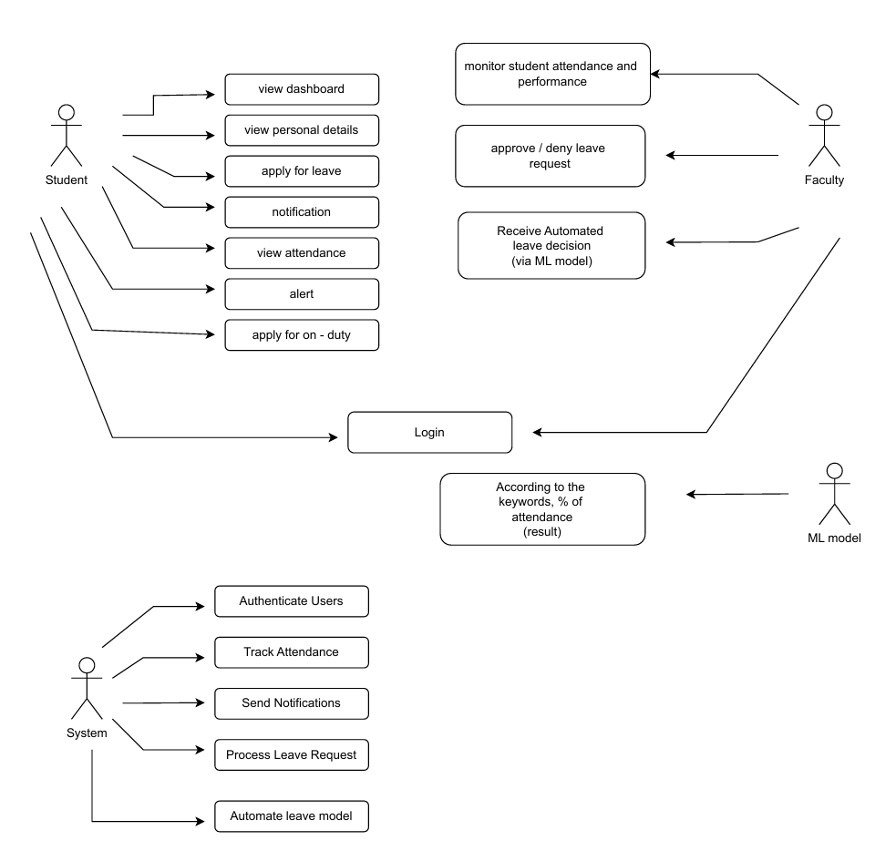
USECASE DIAGRAM

Slide 8
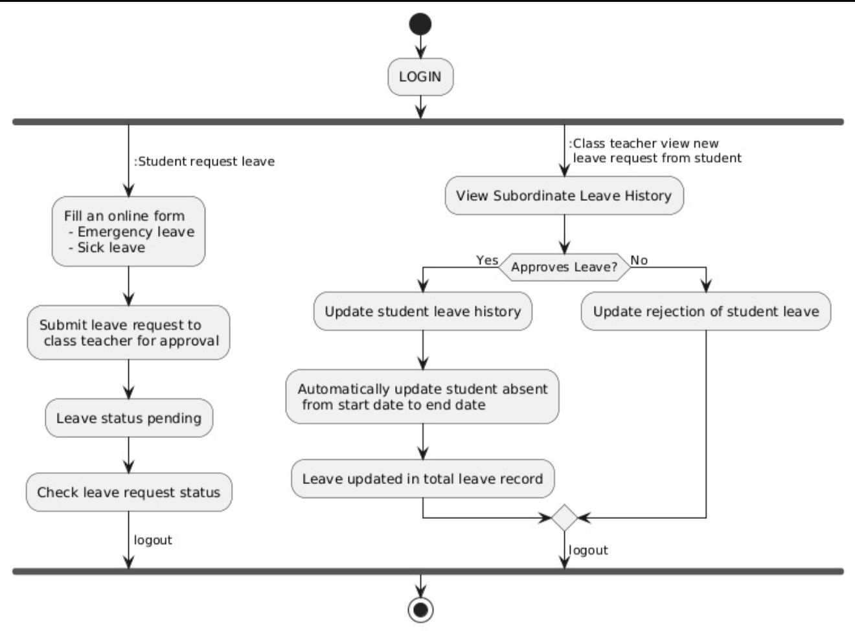
ACTIVITY DIAGRAM

Slide 9
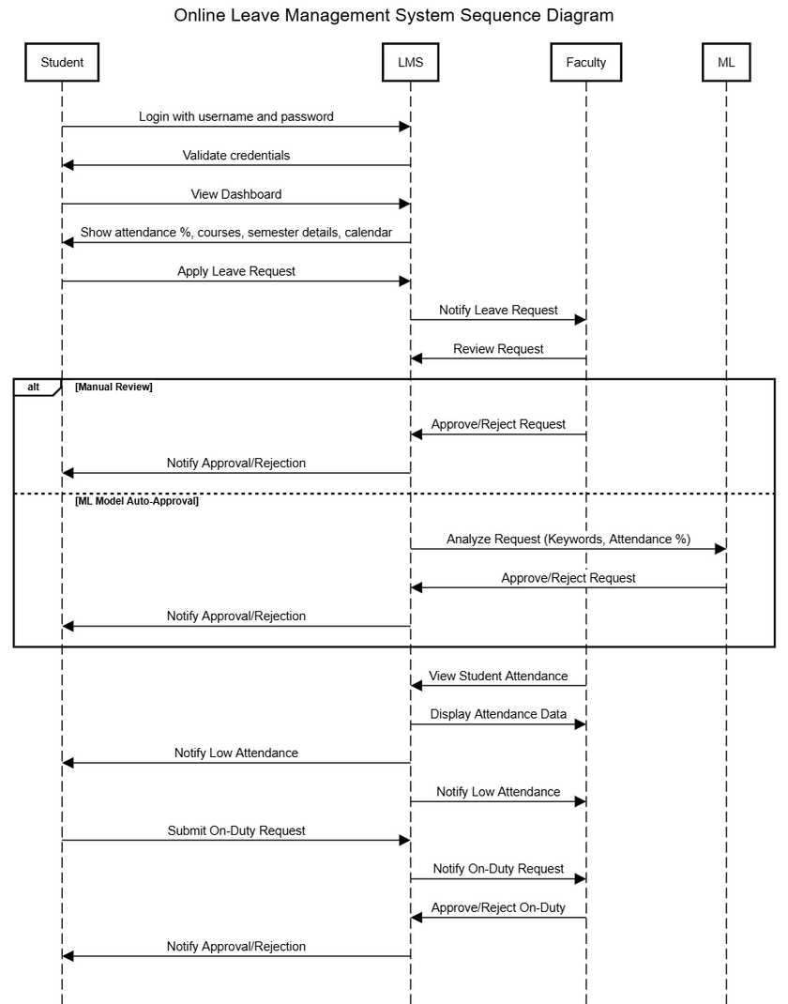
SEQUENCE DIAGRAM

Slide 10
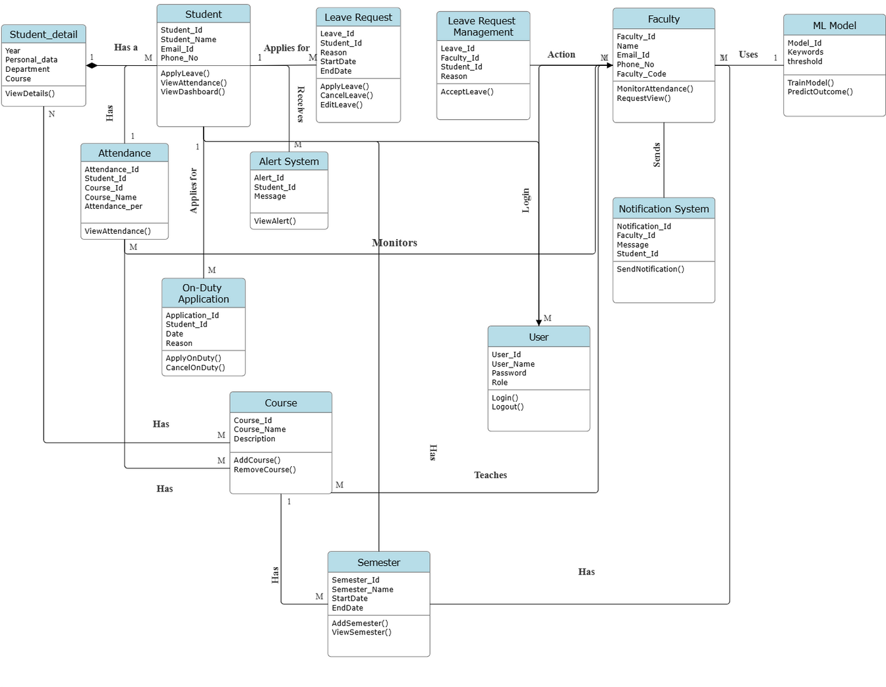
CLASS DIAGRAM

Slide 11

MODULES
Student Module
Faculty Module

Slide 12




STUDENT MODULE
The Student Module in the Leave Management System allows students to apply for leave, track approval status, receive notifications and alert from system for shortage of attendance. Students can also view their leave history, download reports, and manage their profile settings
Students can apply for leave by selecting reason, dates,
Students can track the real-time status of their leave requests
Students receive email/SMS/app notifications for leave status updates
and alert for attendance shortage

Slide 13




FACULTY MODULE
The Faculty Module allows faculty to approve or reject student leave requests and track student attendance. They receive notifications when a student is absent, ensuring timely monitoring. This module helps maintain attendance records and ensures transparency in leave management.
Faculty/advisors are notified automatically when a student applies for leave
Faculty may see an overview of class attendance
Faculty can accept or reject the leave request sent by students

Slide 14

USER INTERFACE DESIGN

Slide 15
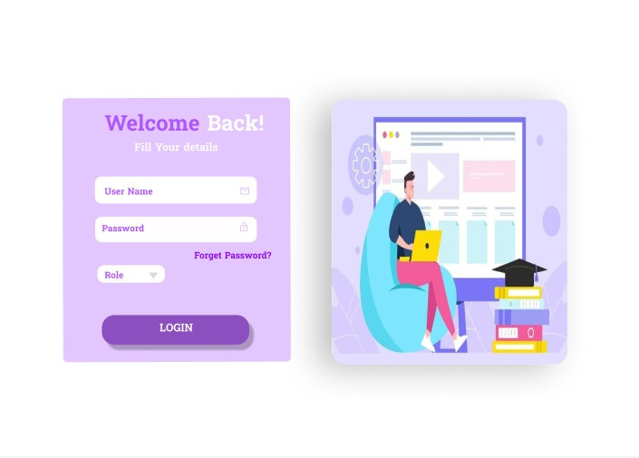
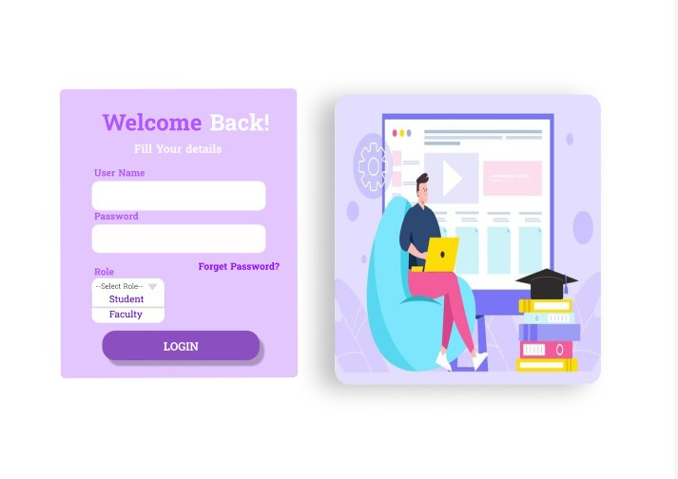
LOGIN PAGE

Slide 16
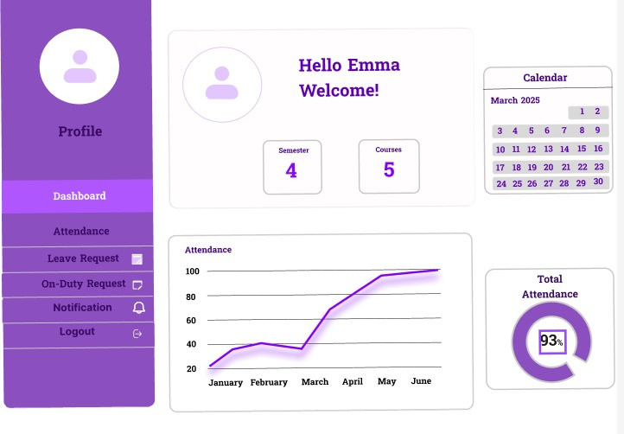
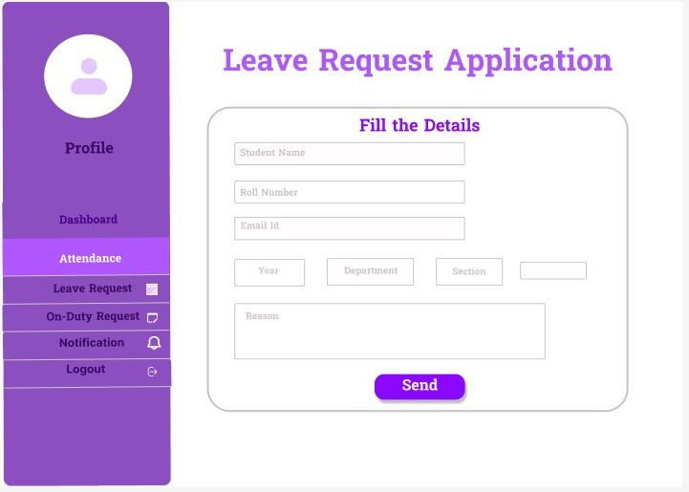
DASHBOARD
LEAVE REQUEST

Slide 17


THANK YOU!

